Slide 1
Docker Networking

Slide 2
What is Docker network
A network is nothing but establishing a communication among the process.
Docker network uses the same concept, it basically used to establish communication between Docker container and its outside world via host on which docker is running.

Slide 3
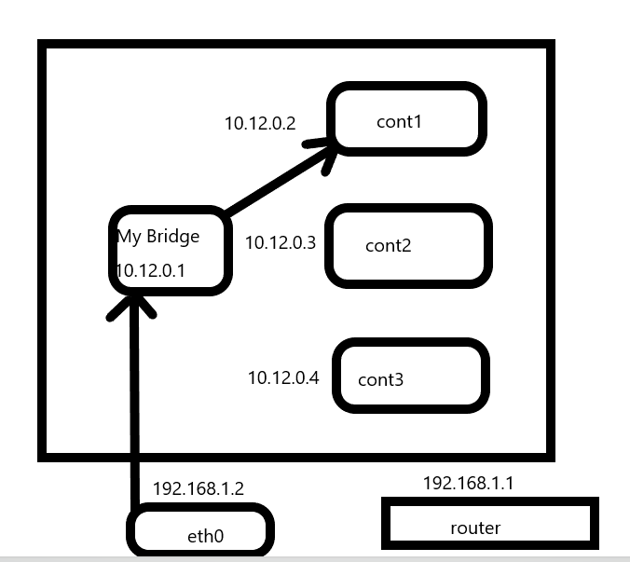

Slide 4
Router : It forwards the traffic directing function on the internet
Eth0 : it’s a gateway for the host
docker0 : it’s a virtual bridge interface created by docker. It chooses a random address and subnet from defined private range.

Slide 5
Docker network command
Command to check available network in docker
Docker network ls
Command to create docker network
Docker network create <network name>

Slide 6
Docker namespace
A container runs in an isolated environment. It will not be able to connect with other container
To make two containers communicate each other, we can create a custom network and connect it with both container.

Slide 7
Command to connect a network with container
Docker connect <network_name> <container_name>

